Slide 1
Hear
Taste
SEE
Smell
fEEL
100
100
100
100
100
200
200
200
200
200
300
300
300
300
300
400
400
400
400
400
500
500
500
500
500

Slide 2
You use these to help you hear things.

Slide 3
What are ears?

Slide 4
Other than your ears, you need this to hear as well.

Slide 5
What is your brain?

Slide 6
When sound vibrations first enter your ear, they hit this strechy skin inside.

Slide 7
What is an eardrum?

Slide 8
These are tiny movements or vibrations in the air.

Slide 9
What are sound waves?

Slide 10
As the sound waves vibrate throughout your ear, these vibrations make nerves send messages here.

Slide 11
What are your brain’s hearing centers?

Slide 12
You use this to help you taste foods.

Slide 13
What is a tongue?

Slide 14
Messages are sent here to help you taste.

Slide 15
What is the brain?

Slide 16
The little bumps on your tongue that molecules in the food go inside to help you taste.

Slide 17
What are taste buds?

Slide 18
Your tongue is split into this many sections, each picking up different tastes.

Slide 19
How many is four?

Slide 20
Not only do you use your tongue and brain to taste, but you also get a lot of help from this sense.

Slide 21
What is smell?

Slide 22
You use these to see objects.

Slide 23
What are eyes?

Slide 24
Not only do you use eyes to see, but this organ is also used a great bit.

Slide 25
What is your brain?

Slide 26
An opening in your eyes to let light in.

Slide 27

What is a pupil?

Slide 28
This is where most of your eye is hidden.

Slide 29
What is the skull?

Slide 30
These carry messages about the picture from the back of your eye to special places in your brain.

Slide 31
What are nerves?

Slide 32
You use this to smell.

Slide 33
What is a nose?

Slide 34
This is the other organ that is used to smell.

Slide 35
What is your brain?

Slide 36
Even though you cannot see these tiny bits, you are able to smell something that is baking in an oven because of them.

Slide 37
What are molecules?

Slide 38
Once the molecules reach the special place in your nose, nearby _____ send messages to your brain.

Slide 39
What are nerves?

Slide 40
True or False: When you put an object closer to your nose, more molecules stick near the nerves.

Slide 41
What is true?

Slide 42
What do you use to feel an object?

Slide 43
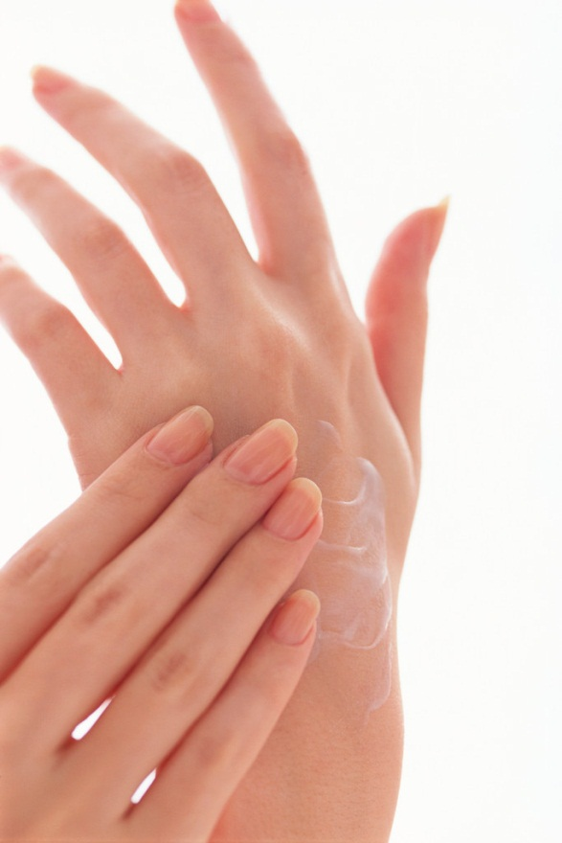
What is skin or a hand?

Slide 44
This is another organ used to feel.

Slide 45
What is the brain?

Slide 46
These are in your skin for touch and pressure, hot and cold, and pain.

Slide 47
What are nerves?

Slide 48
You can tell that a pillow is soft, a rock is hard, a snowball is cold, and a potato is hot by this.

Slide 49

What is feeling?

Slide 50
True or False: Some parts of your body have more touch nerves than others.

Slide 51
What is true?

